Slide 1


Slide 2
OBJECTIVES:
To introduce the idea of Internet security at the network layer and the IPSec protocol that implements that idea in two modes: transport and tunnel.
To discuss various protocols in IPSec, AH and ESP, and explain the security services each provide.
Key Management protocol (ISAKMP, Oakley determination)
To introduce security association and its implementation in IPSec.
To introduce virtual private networks (VPN) as an application of IPSec in the tunnel mode.

Slide 3
Chapter
Outline
1 Network Layer Security

Slide 4
1. NETWORK LAYER SECURITY
In 1995, Internet Engineering Task Force (IETF) designed IP Security (IPSec).
It is a collection of protocols to provide security for a packet at the network level.
IPSec helps create authenticated and confidential packets by offering Integrity protection for the IP layer.

Slide 5
Topics Discussed in the Section
Two Modes
Four Security Protocols
Services Provided by IPSec
Security Association
Internet Key Exchange (IKE)
Virtual Private Network (VPN)

Slide 6
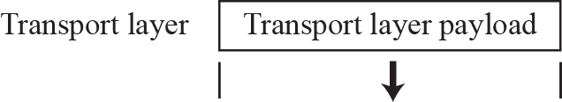
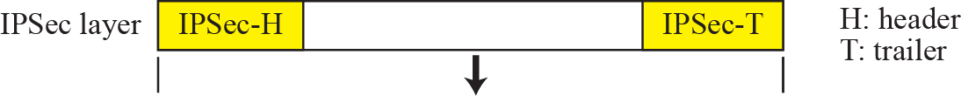
Concept of Transport Mode
Figure .1 IPSec in transport mode

Slide 7

Note
IPSec in transport mode does not protect the IP header;
it only protects the information coming from the transport layer.

Slide 8
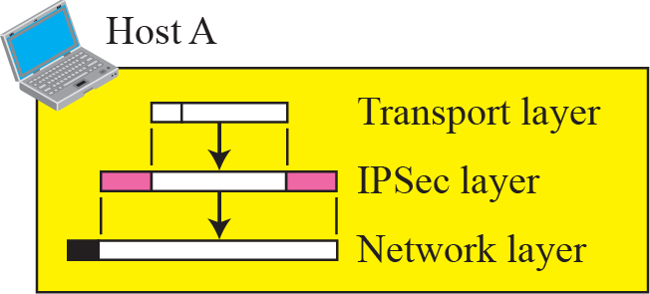
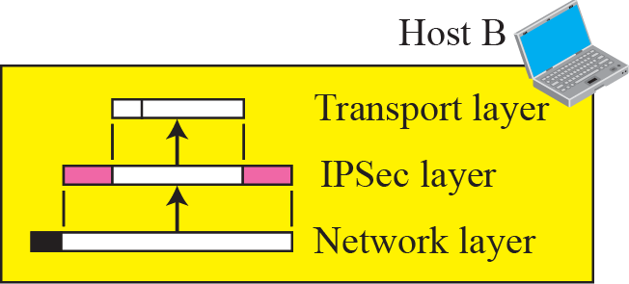
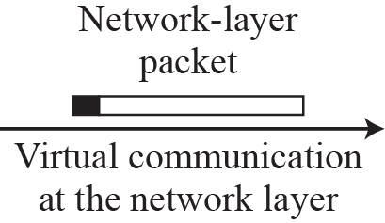
Figure .2 Transport mode in Action
Host-to-Host (end-to-end) encryption

Slide 9
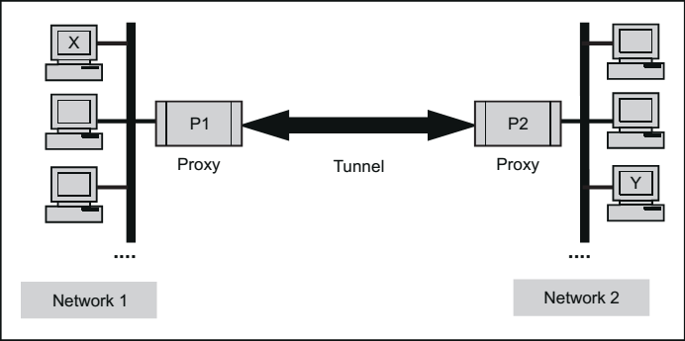
Concept Of Tunnel Mode
Logical encrypted /imaginary tunnel

Slide 10
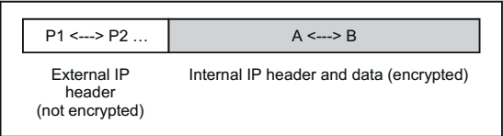
Implementation Of Tunnel Mode

Slide 11
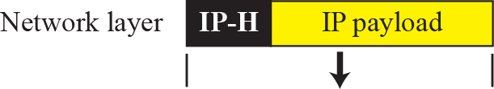
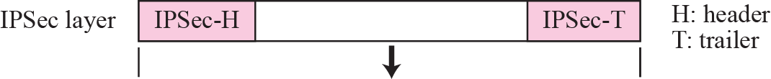
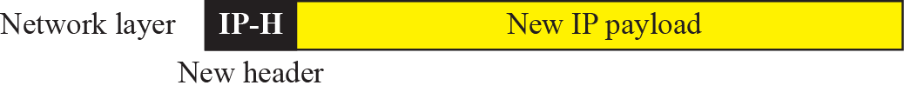
Figure .3 IPSec in tunnel mode
Protect the original packet & IP header

Slide 12
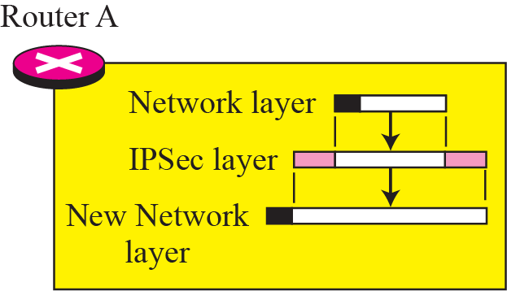
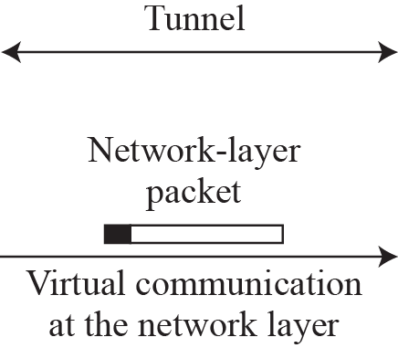
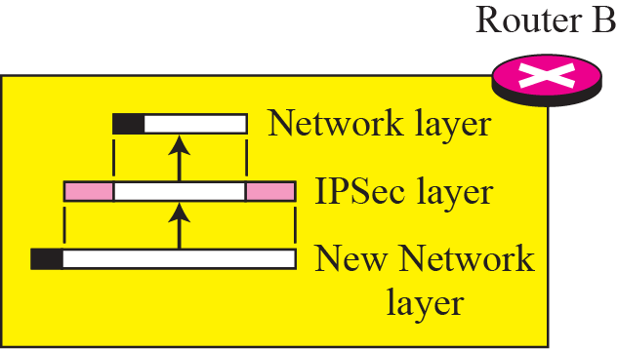
Figure .4 Tunnel-mode in action
Tunnel
Router to Router
Router to Host
Host to Router

Slide 13
Note
IPSec in tunnel mode protects the original IP header.

Slide 14
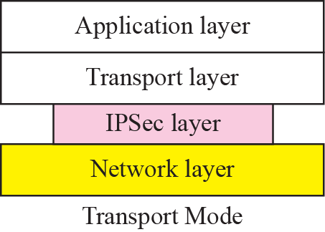
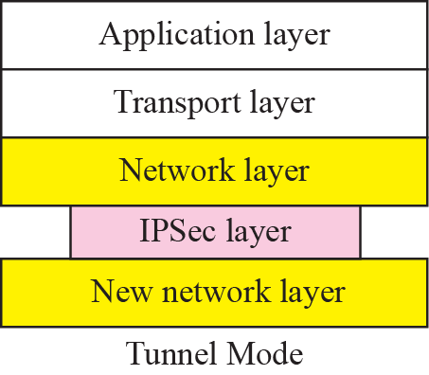
Figure.5 Transport mode versus tunnel mode

Slide 15
Note
The AH protocol provides source authentication and data integrity , anti-replay service but not privacy
Contains MD/Hash/Checksum for content of packet.

Slide 16
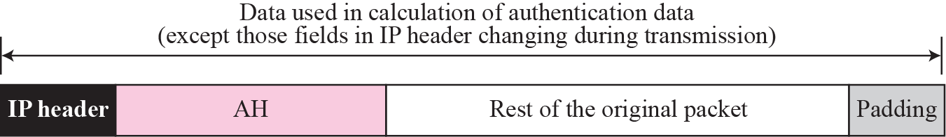
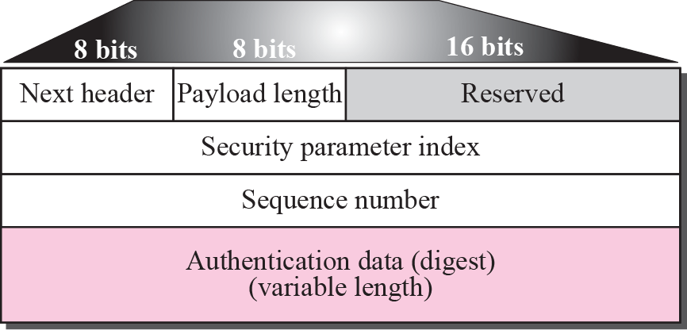
Figure.6 Authentication Header (AH) protocol

Slide 17
Note
ESP provides source authentication, data integrity, and privacy.

Slide 18
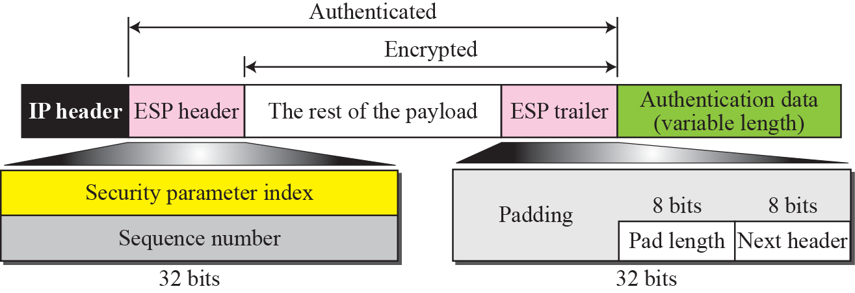
Figure .7 Encapsulating Security Payload (ESP) for Encryption

Slide 19
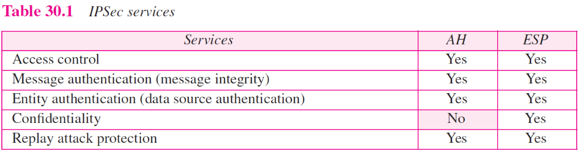

Slide 20
Secure Connectivity Over Internet
-> VPN
Secure Remote Access Over Internet
-> Company N/W
Extranet & Intranet Connectivity
-> Other Organization
Enhanced E-Commerce Security
-> Applications

Slide 21
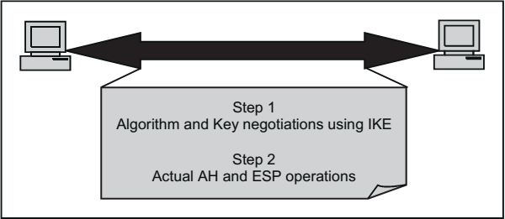
The Internet Key Exchange(IKE)

Slide 22
Note
IKE creates SAs for IPSec.

Slide 23
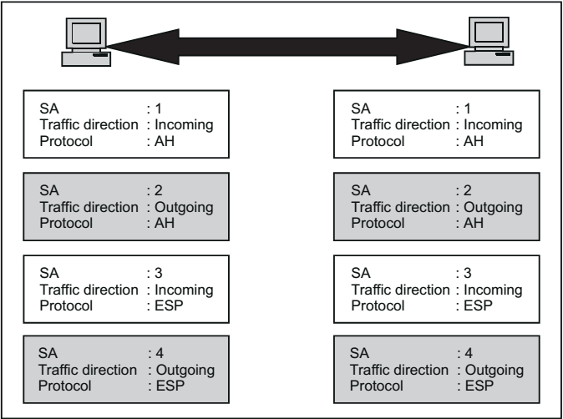
Security Association(SA)

Slide 24
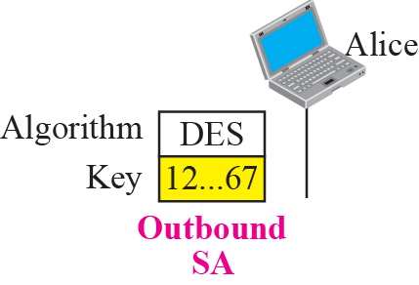
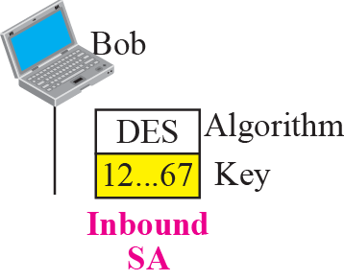
Figure.8 Simple SA

Slide 25
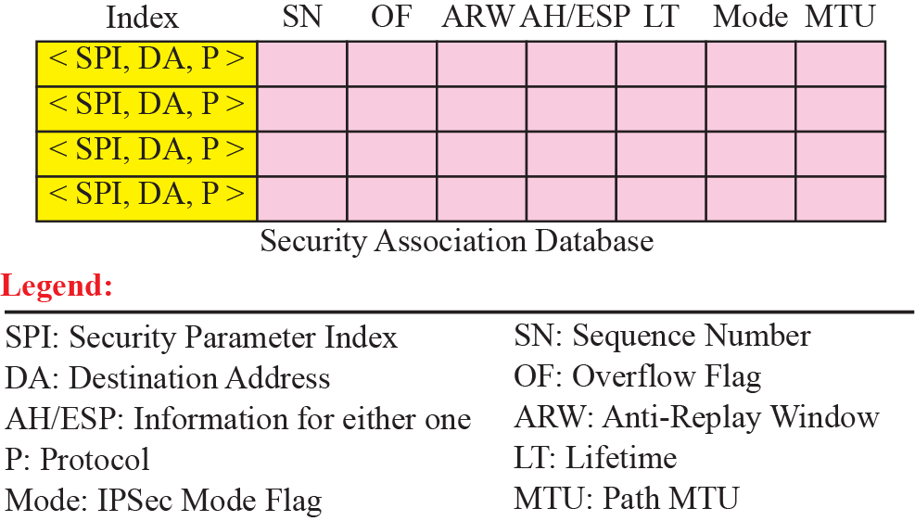
Figure.9 SAD (Security Association DB)

Slide 26
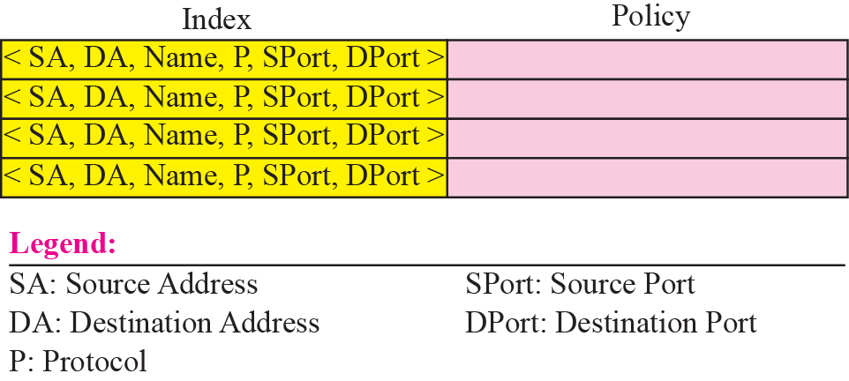
Figure.10 SPD (Security Policy DB )
which determines how a message are to handle also the security services needed & path the packet should take.

Slide 27
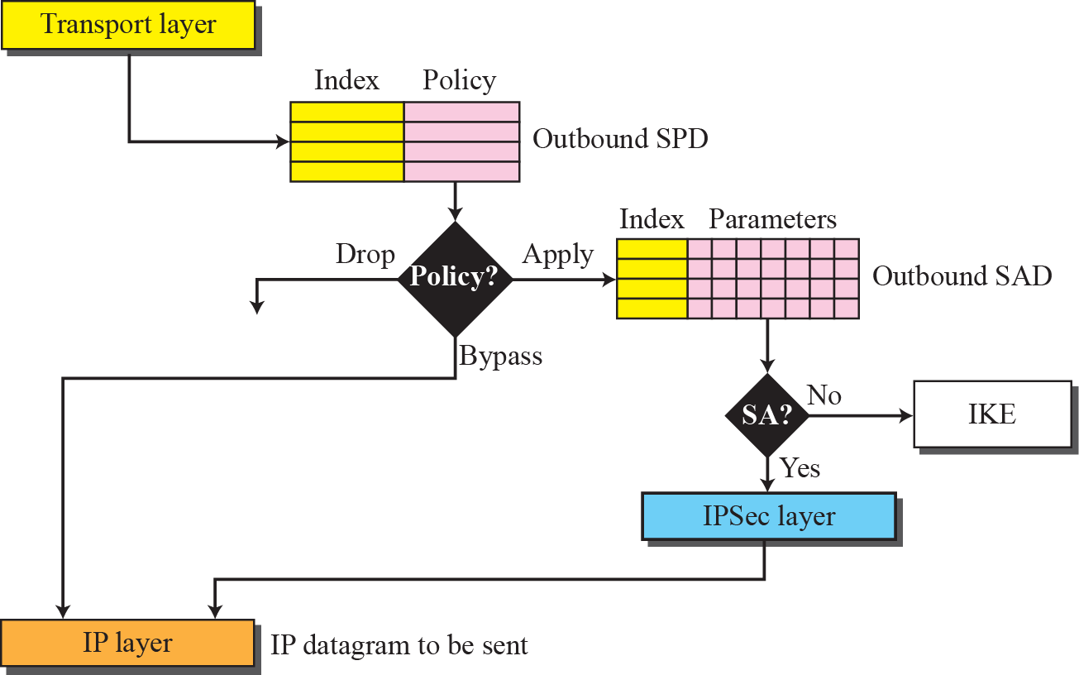
Figure.11 Outbound processing

Slide 28
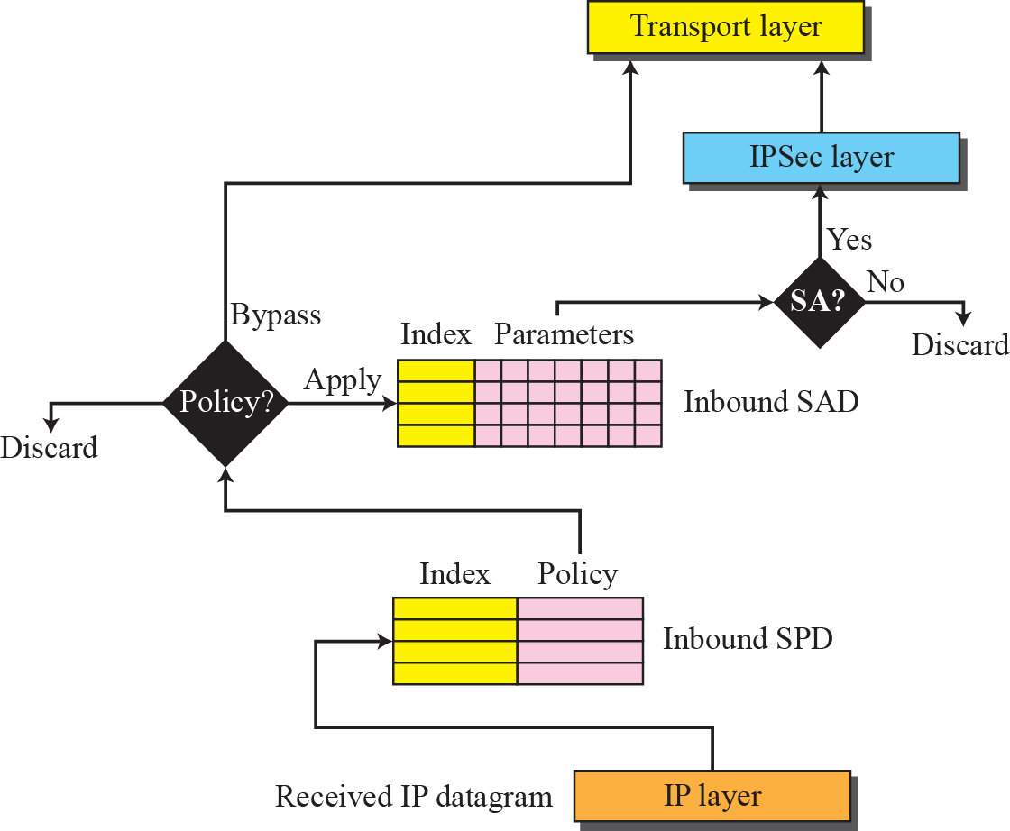
Figure.12 Inbound processing

Slide 29
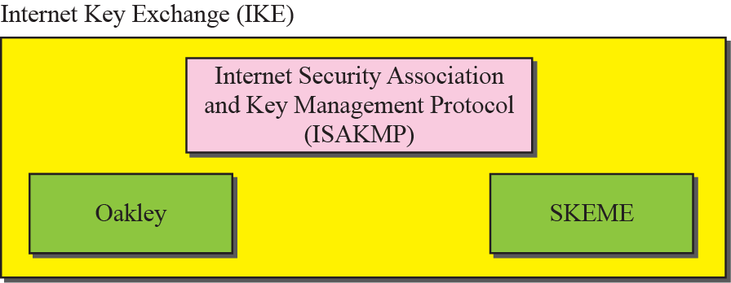
Figure.13 IKE components

Slide 30
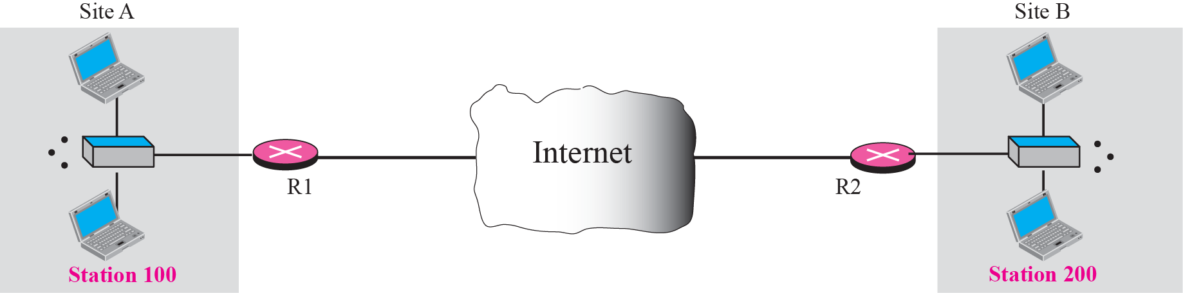
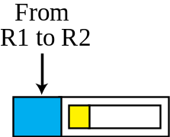
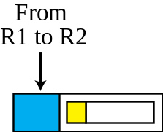
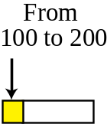
Figure.14 Virtual private network

Slide 31
2-TRANSPORT LAYER SECURITY
Secure Sockets Layer (SSL) protocol
Web Browser & Server(i.e:- web security)
Authentication & Confidentiality
Netscape Corporation in 1994
Version 2,3,3.1
Transport Layer Security (TLS) protocol version 1.
IETF Standardization initiative.

Slide 32
OBJECTIVES (continued):
To introduce the idea of Internet security at the transport layer.
The SSL protocol encrypt only application level data
To show how SSL creates six cryptographic secrets to be used by the client and the server.
To discuss four protocols used in SSL and how they are related to each other.

Slide 33
Topics Discussed in the Section
SSL Architecture
Four Protocols

Slide 34
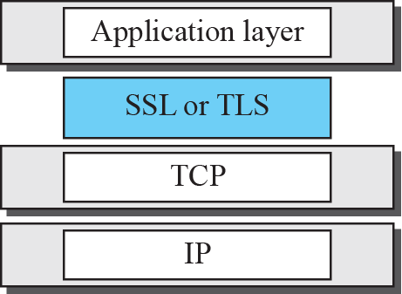
Performs Encryption
Adds SSL Header(SH)
Figure 30.15 Location of SSL and TSL in the Internet mode

Slide 35
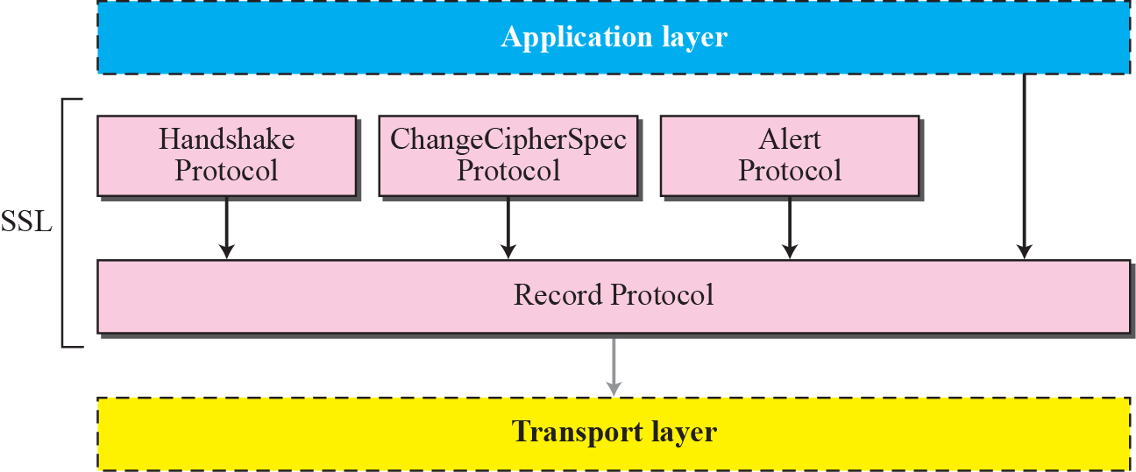
Figure 30.19 Four SSL protocols

Slide 36
Handshake Protocol
Type (1byte) | Length (3byte) | Content (1 or more Byte)
Message Type
Parameters
Hello request
None
Client hello
Version, Random number, Session id, Cipher suite, Compression method
Server hello
Version, Random number, Session id, Cipher suite, Compression method
Certificate
Chain of X.509V3 certificates
Server key exchange
Parameters, signature
Certificate request
Type, authorities
Server hello done
None
Certificate verify
Signature
Client key exchange
Parameters, signature
Finished
Hash value

Slide 37
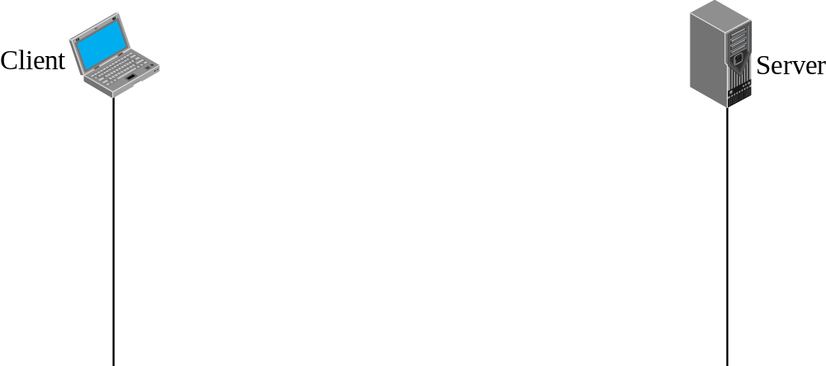
Figure 30.20 Handshake protocol

Slide 38
SSL Handshake – Phase 1
Web Browser
Web Server
Step 1: Client hello
Step 2: Server hello
Fig

Slide 39
Note
After Phase I, the client and server know the version of SSL, the cryptographic algorithms, the compression method, and the two random numbers for key generation & Session id.

Slide 40
SSL Handshake – Phase 2
Step 1: Certificate
Web Browser
Web Server
Step 2: Server key exchange
Step 3: Certificate request
Step 4: Server hello done

Slide 41
Note
After Phase II, the server is authenticated to the client, and
the client knows the public
key of the server if required.

Slide 42
SSL Handshake – Phase 3
Web Browser
Step 1: Certificate
Web Server
Step 2: Client key exchange
Step 3: Certificate request

Slide 43
Note
After Phase III, The client is authenticated for the serve, and
both the client and the server
know the pre-master secret.

Slide 44
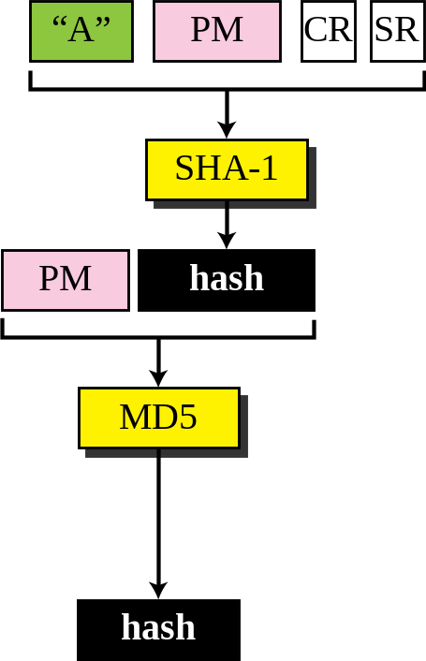
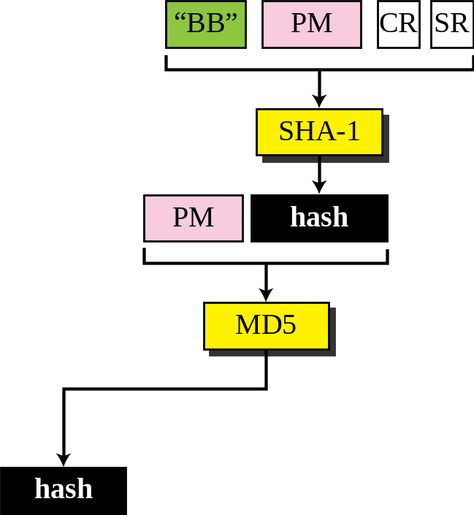
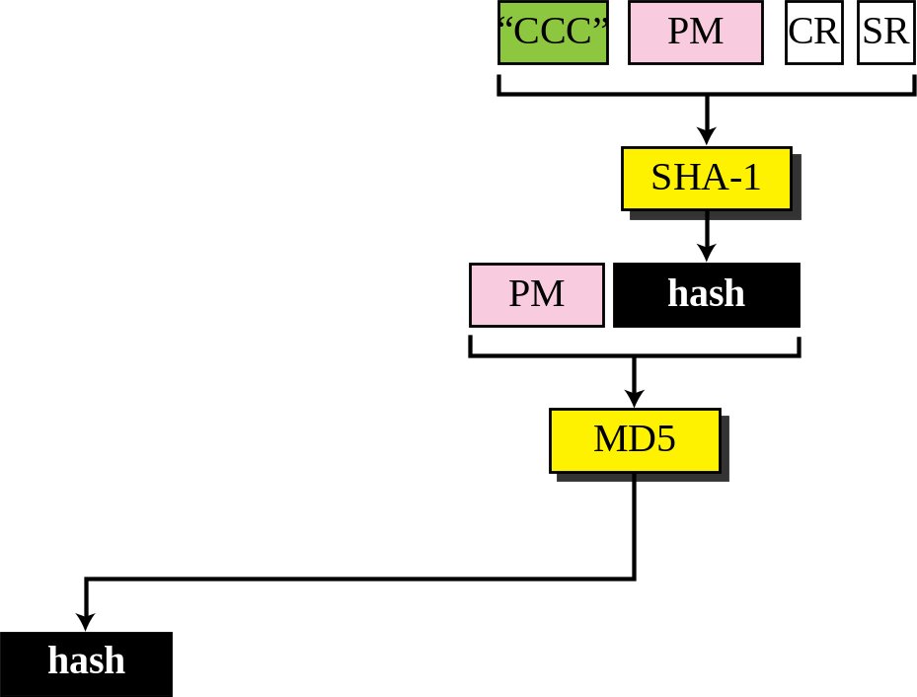
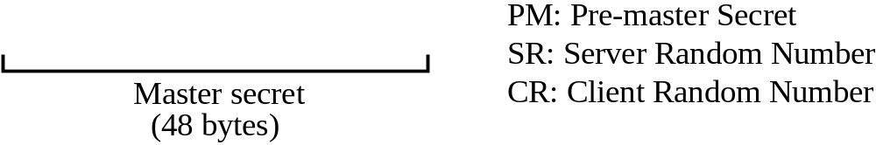
Figure.16 Calculation of maser key generation from pre-master secret

Slide 45
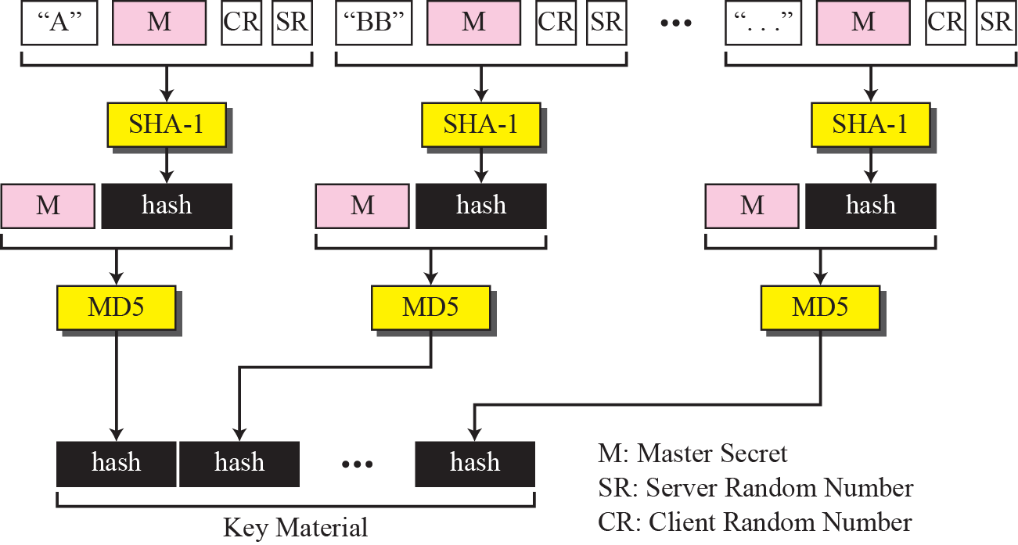
Figure .17 Calculation of the key materials(symmetric key) generation M

Slide 46
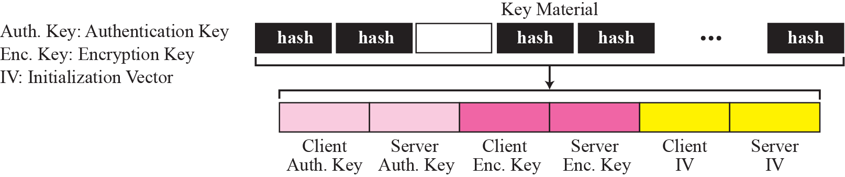
Figure .18 Extraction of cryptographic secrets from key materials

Slide 47
SSL Handshake – Phase 4
1. Change cipher specs
Web Browser
Web Server
2. Finished
Step 3: Change cipher specs
Step 4: Finished

Slide 48
SSL Handshake
Client
SSL
Server
Client Hello
Server Hello
Phase 1
Certificate
Server Key Exchange
Phase 2
Certificate Request
Time
Server Hello done
Certificate
Client Key Exchange
Phase 3
Certificate Verify
Change Cipher Spec
Finished
Phase 4
Change Cipher Spec
Finished

Slide 49
SSL Record Protocol
It transfer application & SSL information.
Confidentiality
  using symmetric encryption with a shared secret key defined by Handshake Protocol
  message is compressed before encryption
Integrity
  using a MAC with shared secret key

Slide 50
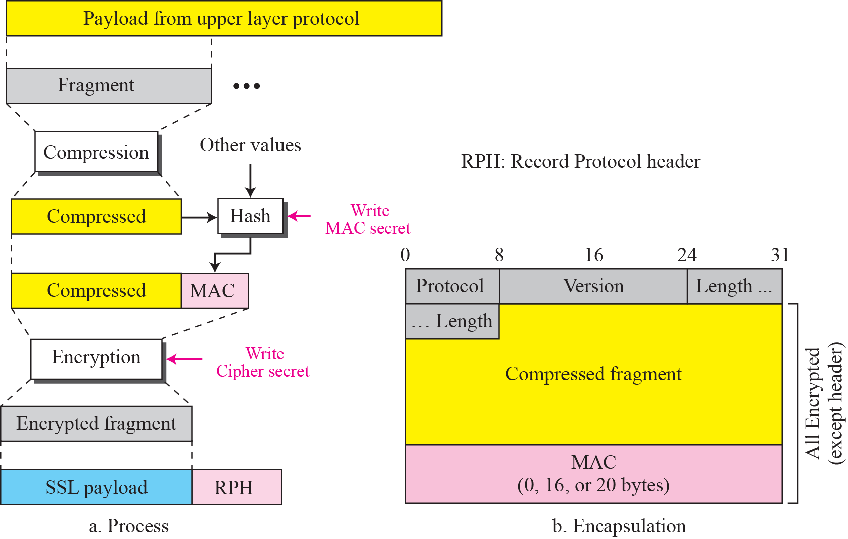
Figure .21 Processing done by the record protocol
2^14 bytes

Slide 51
Append Header
Content Type:-Handshake, alert, change chiper.
Major Version:-if 3.1 field contain 3
Minor Version:-if 3.0 field contain 0
Compressed Length:-Specifies the length in bytes(Original or Compressed if done)

Slide 52
SSL Alert Protocol
conveys SSL-related alerts to peer entity
Severity (1 byte)
    Type of error
    Warning:-1
    Fatal:-2
    Cause (2 byte)
    Actual Error
Fatal Alert
    unexpected message , bad record mac(MAC）, decompression failure, handshake failure, illegal parameter.
    Non-Fatal Alert
    no certificate, bad certificate, unsupported certificate, certificate revoked, certificate expired, certificate unknown, close notify.

